Slide 1
Positively Native

Slide 2

What is HIV/AIDS?
HIV = Human Immunodeficiency Virus
AIDS = Acquired Immunodeficiency Syndrome
HIV is a virus that attacks cells in the body’s immune system.
Without treatment, it becomes increasingly difficult for the immune system to fight off infections and diseases, such as pneumonia and certain cancers.
The presence of these infections and diseases indicate that a person has AIDS, the last stage of HIV infection.

Slide 3

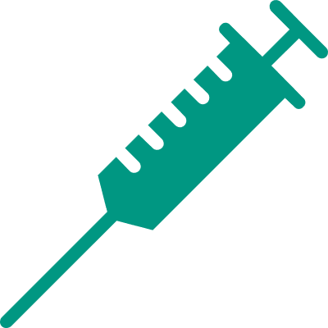



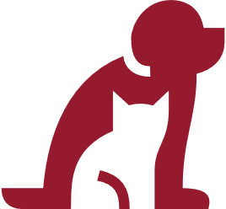

Transmission
HIV CAN BE TRANSMITTED BY
Sexual Contact
Sharing Needles
Mother to Baby
During Pregnancy, Birth, or Breastfeeding
HIV IS NOT TRANSMITTED BY
Air or Water
Saliva, Sweat, Tears
Pets or Insects
Sharing Food, Drinks

Slide 4




Prevention
Talk to Your Partner(s) about HIV
Get Tested for HIV
Use Condoms During Sex
Do Not Share Needles to Inject Drugs
Take HIV
Prevention Medicines
(PrEP and PEP)

Slide 5
PrEP and PEP
PrEP
Pre-exposure Prophylaxis (PrEP) is a daily pill that prevents HIV in people
at risk of contracting HIV.
PrEP can reduce the risk of contracting HIV by
  99% for sex
  74%. for shared needles
PrEP must be taken consistently
to be effective
PEP
Post-exposure Prophylaxis (PEP) is
a pill taken after exposure to HIV
to prevent HIV infection.
PEP must be started within 72 hours
of exposure.
PEP is effective in preventing HIV,
but not 100%.
Source: CDC (2019). HIV Basics: Prevention. Retrieved January 29, 2020, from https://www.cdc.gov/hiv/basics/prevention.html

Slide 6

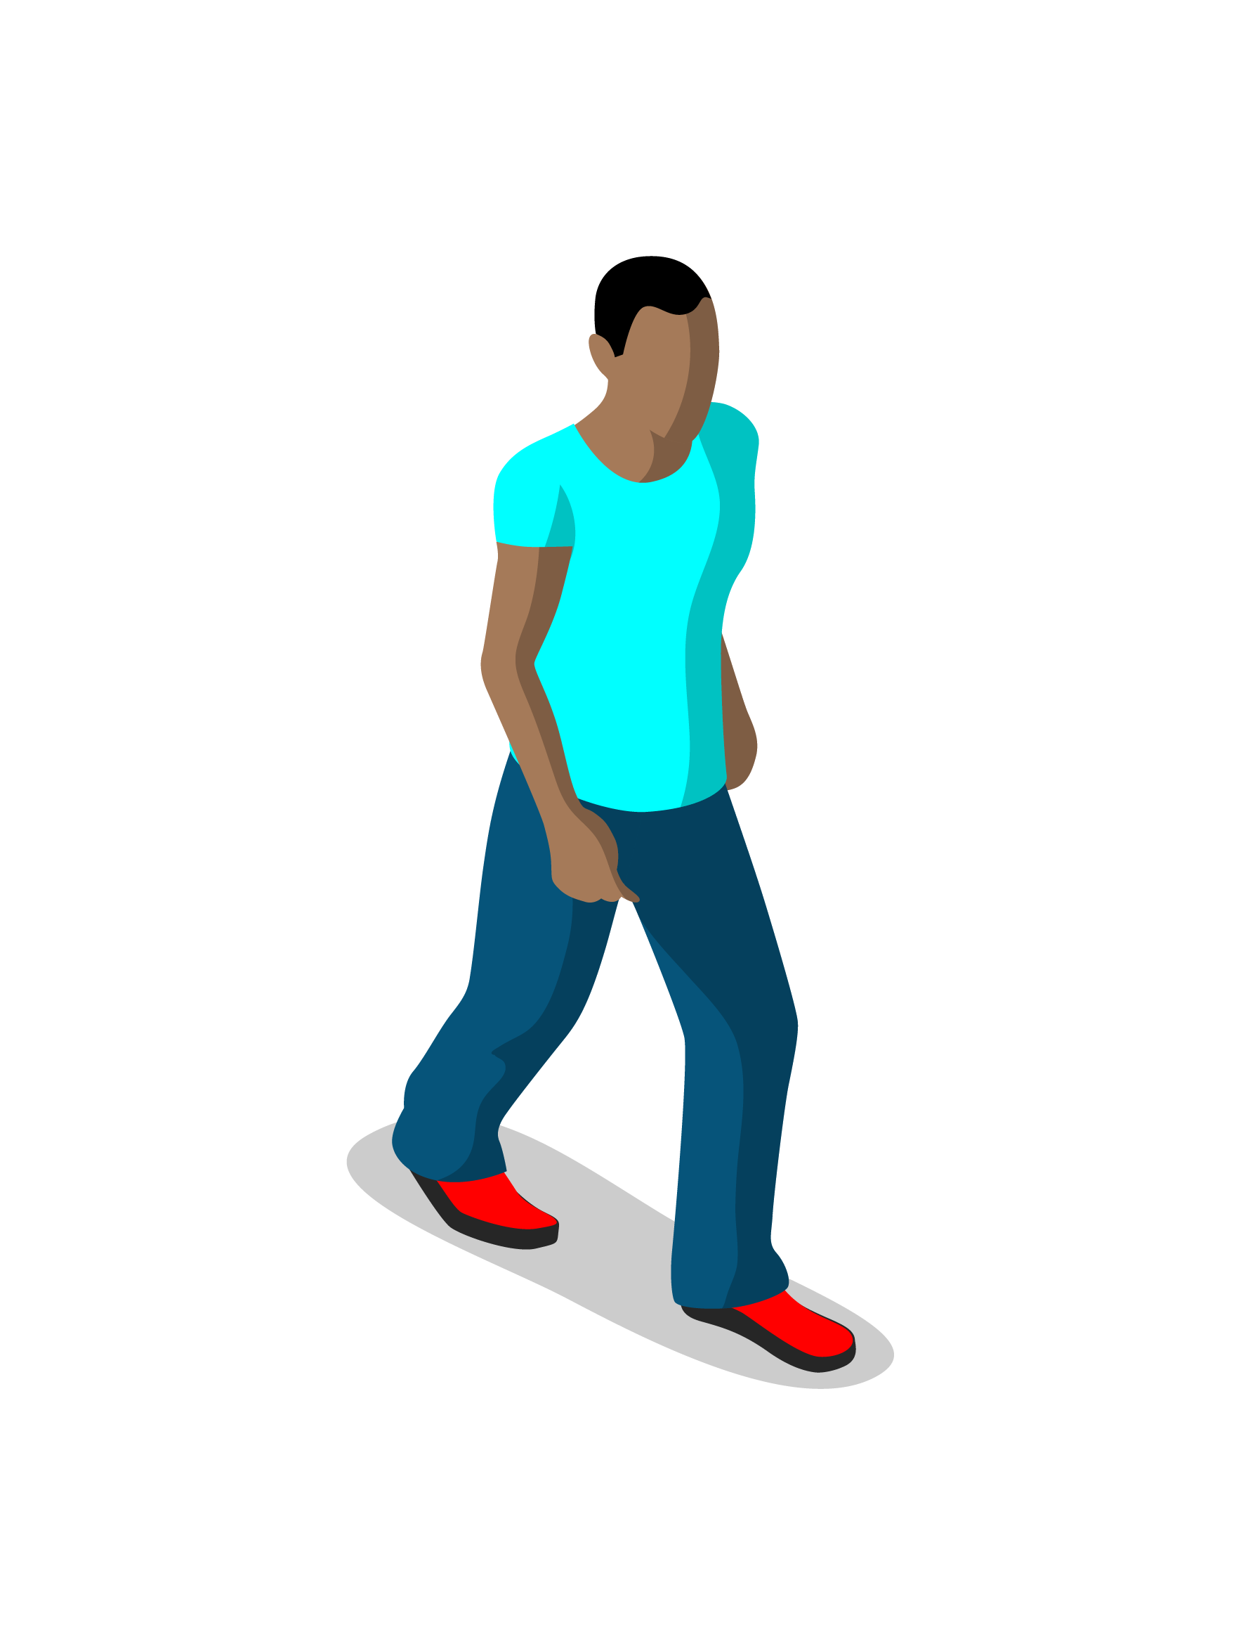
Treatment
Antiretroviral Therapy (ART) is a combination of drugs taken to reduce the amount of HIV in blood and body fluids.
ART can lower the amount of HIV in blood and body fluids to undetectable levels, making HIV untransmittable through sex.
Undetectable = Untransmittable
6

Slide 7
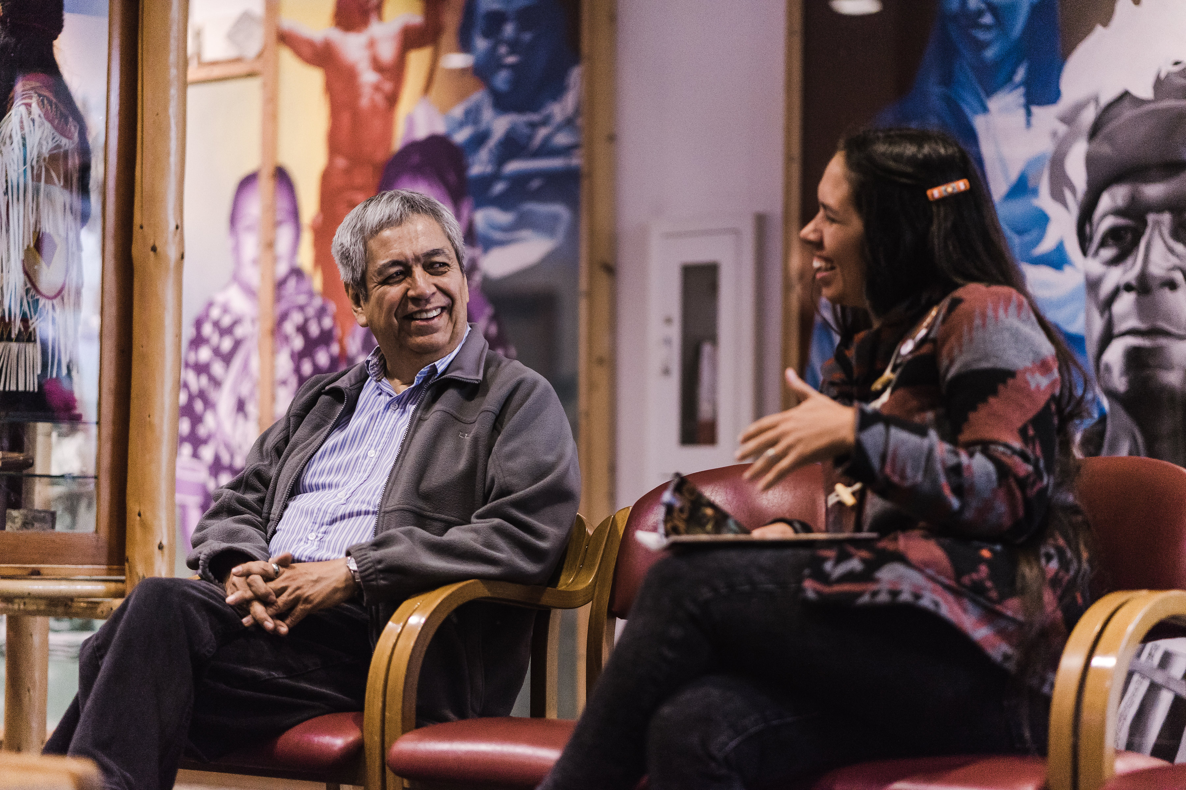
Stigma & Discrimination
HIV stigma is negative beliefs, feelings, and attitudes about people living with HIV.
Discrimination is the unfair and unjust treatment of someone resulting from those negative attitudes, feelings, or beliefs.
  Refusing housing, healthcare, or work to someone because
  they have HIV.
  Socially isolating a community member because they are living with HIV.

Slide 8
HIV in American Indians/Alaska Natives
 | # of Cases | Rate
Number of HIV Diagnoses (2017)
AI/AN | 212 | 8.8
White | 10,048 | 5.1
Number of AIDS Diagnoses (2017)
AI/AN | 72 | 3.0
White | 4,321 | 2.2
* Rate is per 100,000 people
Source: CDC (2018). HIV Surveillance Report, 2017, 29. Retrieved from https://www.cdc.gov/hiv/pdf/library/reports/surveillance/cdc-hiv-surveillance-report-2017-vol-29.pdf

Slide 9


HIV in AI/ANs (Cont.)
It is estimated that 3,600 AI/ANs are living with HIV in the US.
  However, this number is most likely higher due to AI/ANs being misclassified as another race.
From 2010 to 2016, the annual number of HIV diagnoses increased 46% among AI/AN.
  Among gay and bisexual AI/AN men, the number of HIV diagnoses increased by 81%.
Source: CDC (2019). HIV and American Indians and Alaska Natives. Retrieved January 29, 2020, from https://www.cdc.gov/hiv/basics/livingwithhiv/stigma-discrimination.html
Source: CDC (2018). HIV Surveillance Report, 2017, 29. Retrieved from https://www.cdc.gov/hiv/pdf/library/reports/surveillance/cdc-hiv-surveillance-report-2017-vol-29.pdf

Slide 10

Video

Slide 11
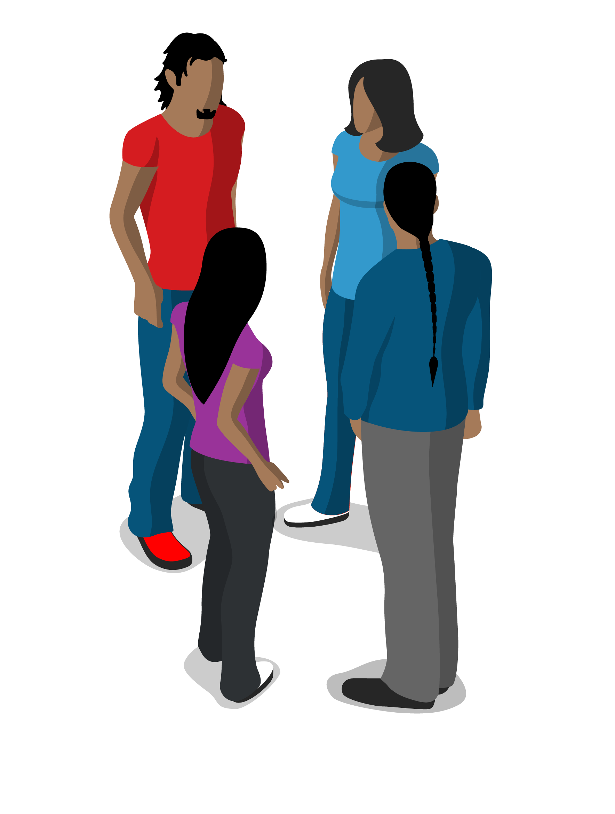
Discussion Agreements
Introduce yourself
Listen respectfully, without interrupting
Allow everyone a chance to speak
Stay on topic
Any others?

Slide 12

Discussion Questions
What are your first thoughts after watching the video?
Do people in your community talk about HIV and how to prevent it?
What can you do to help stop stigma and discrimination in your community and beyond?
How will you continue this discussion moving forward?
I learned, I hope, or I feel…..

Slide 13
Thank you!
For more information, please contact us
at info@uihi.org.

